Slide 2
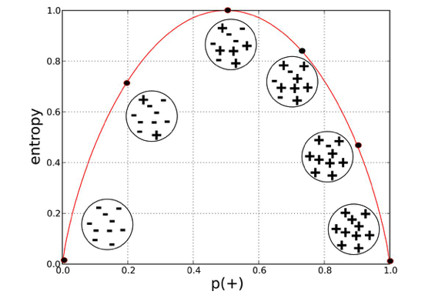

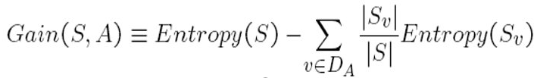
ID3 algorithm mainly includes the following steps:
​1) Calculating the entropy of the dataset
2) For each attribute
I. Calculating the entropy of all attributes
II. Calculating the information gain of all attributes
3) Using the ID3 algorithm to build a decision tree and train the data
4) Making predictions
Entropy,
1. Probability(Both Class) = 0.5 & Entropy = 1
2.Probability(Either or Both Class) = 0 & Entropy = 0 it is called Leaf Node & stop Split
Information Gain
If the value of information gain is larger, it means that the feature is more important, and the attribute is higher in the decision tree.

Slide 3
Decision tree is a supervised learning model that can be applied to classification and regression problems. Decision tree model essentially summarizes a set of classified rules from a training dataset.
It can be thought of as a set of if-else statements, or can also be a conditional probability distribution defined in a feature space.
Through the rules obtained in the training set, the unknown data is predicted and classified.
A decision tree mainly consists of three parts: tree nodes, branches and leaves. Each tree node represents a problem or a decision and is also an attribute of the classification object
ID3 → (extension of D3)
C4.5 → (successor of ID3)
CART → (Classification And Regression Tree)
CHAID → (Chi-square automatic interaction detection Performs multi-level splits when computing classification trees)
MARS → (multivariate adaptive regression splines)
ID3 (Iterative Dichotomiser 3) algorithm was first proposed by J. Ross Quinlan at the University of Sydney in 1975

Slide 4
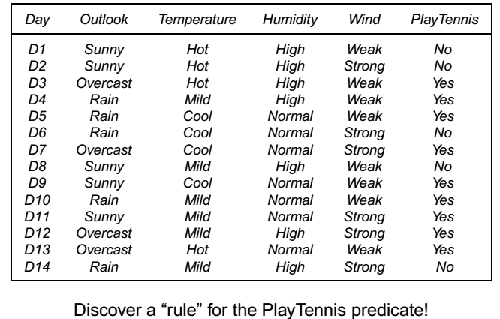

Slide 5
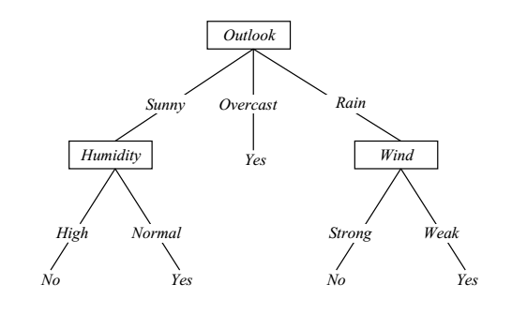
List of Attributes: [‘outlook, ‘temperatwre’, ‘humidity’, ‘wind’, ‘play’] Predicting Attributes: [‘outlook’, ‘temperature’, ‘humidity’, ‘wind’] Decision tree: {‘outlook’: {‘overcast’: ‘yes’, ‘rainy’: {‘wind’, {‘strong’: ‘no’, ‘weak’, ‘yes’}}, 'sunny’: {‘humidity’: {‘high’: ‘no’, ‘normal’: ‘Yes}}}}

Slide 6
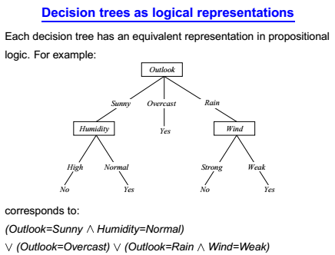

Slide 8
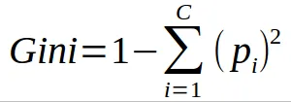
CART (Classification and Regression Tree)
Steps of CART Algorithms:
1. Select Root node(S) based on Gini Index and Highest Information Gain
2 . On each iteration of an algorithms it calculate the Gini Index and Information gain, considering that every node is unused
3. Select node base on Lowest Gini Index or Highest I.G
4. then Splits set S to produce the subsets of data
5. An algorithms continuous to recur on each subset and make sure that attributes are fresh and Creates the decision Tree

Slide 9
Outlook | Temperature | Humidity | Wind | Gameplay?
Sunny | High | High | Weak | False
Sunny | High | High | Strong | False
Cloudy | High | High | Weak | True
Rainy | Mild | High | Weak | True
Rainy | Low | Normal | Weak | True
Rainy | Low | Normal | Strong | False
Cloudy | Low | Normal | Strong | True
Sunny | Mild | High | Weak | False
Sunny | Low | Normal | Weak | True
Rainy | Mild | Normal | Weak | True
Sunny | Mild | Normal | Strong | True
Cloudy | Mild | High | Strong | True
Cloudy | High | Normal | Weak | True
Rainy | Mild | High | Strong | False
https://pradeep-dhote9.medium.com/decision-tree-classification-and-regression-algorithm-cart-id3-36a2450a7f1a
https://medium.com/@singhakshay.etw69/decision-tree-algorithm-cart-e61032794927

Slide 10
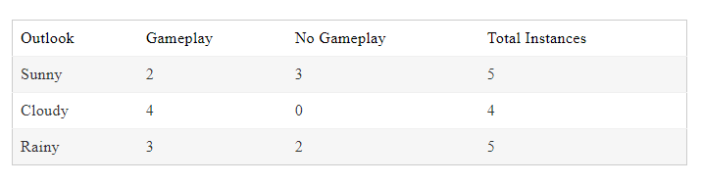
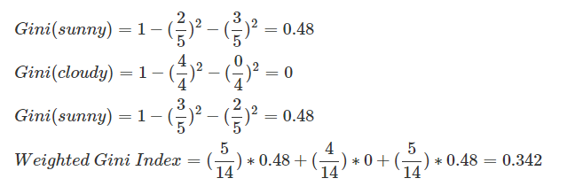
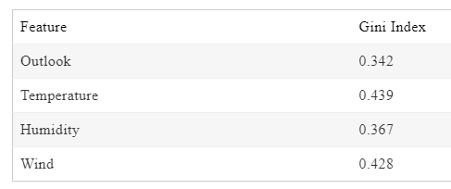

Slide 11
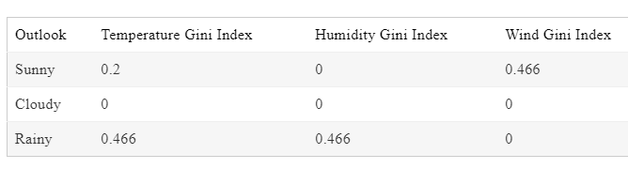
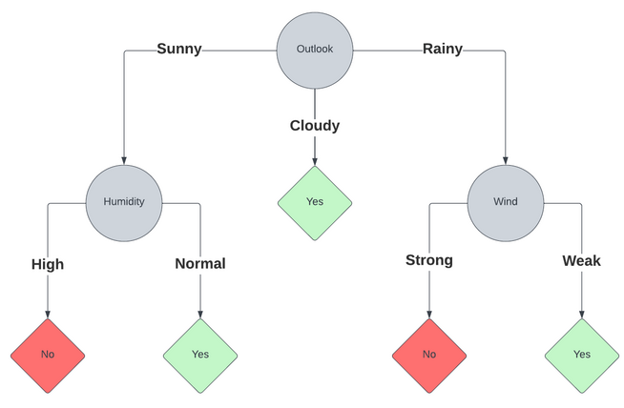

Slide 12
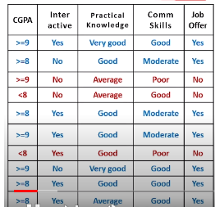

Slide 13
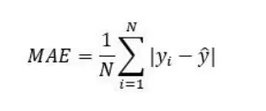
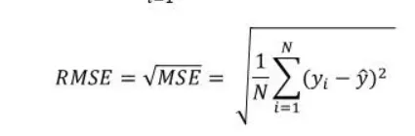
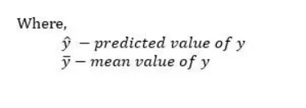
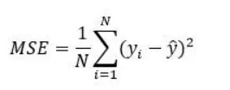
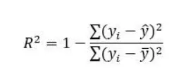
Error bounds

